Slide 1
Various Technique to Optimize Neural Networks

Slide 2
Content
Activation Functions
Good Initialization
Drop-Out
Batch Normalization

Slide 3
Activation Functions

Slide 4
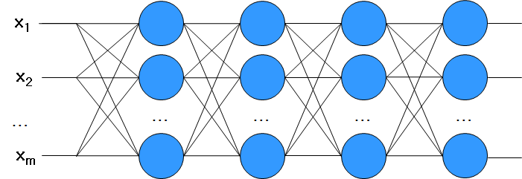
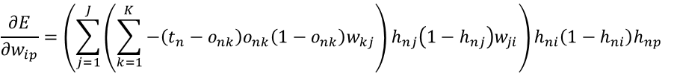
Gradient Vanishing & Exploding
Gradient is easy to vanish or explode
To many terms are multiplied.
If some are small numbers, gradient becomes very small.
If some are large numbers, gradient becomes very large.
$$\frac{∂E}{∂w_{ip}}=\left(\sum_{j=1}^{J}{\left(\sum_{k=1}^{K}{−\left(t_{n}−o_{nk}\right)o_{nk}\left(1−o_{nk}\right)w_{kj}}\right)h_{nj}\left(1−h_{nj}\right)w_{ji}}\right)h_{ni}\left(1−h_{ni}\right)h_{np}$$

Slide 5
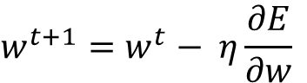
Gradient Vanishing & Exploding
Why Gradient Exploding is bad?
A big jump in the gradient descent method can cause a divergence which means a failure of learning
To avoid
Use small learning rate
Small learning rate causes slow learning!!
Anyway, it is one of good ways to avoid gradient exploding
$$w^{t+1}=w^{t}− η\frac{∂E}{∂w}$$
Small learning rate can curtail a large gradient

Slide 6
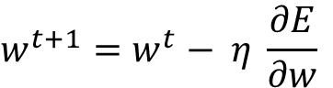
Gradient Vanishing & Exploding
Then, how about Gradient Vanishing?
Small learning rate aggravates gradient vanishing problems
We can find a solution in another way
Learning rate is small, so
Let’s make the gradient not too small
$$w^{t+1}=w^{t}− η \frac{∂E}{∂w}$$
Small gradient
Small learning rate

Slide 7
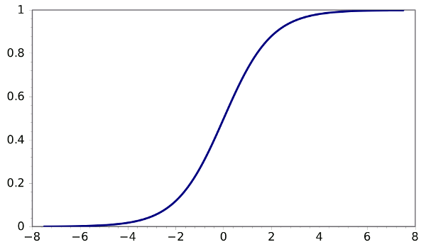
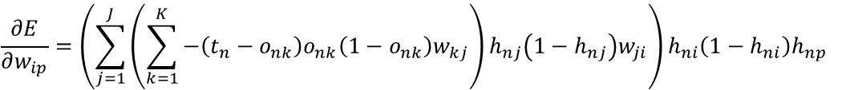
Activation Function
Vanishing Gradient
The major terms are the derivatives of the activation function
$$\frac{∂E}{∂w_{ip}}=\left(\sum_{j=1}^{J}{\left(\sum_{k=1}^{K}{−\left(t_{n}−o_{nk}\right)o_{nk}\left(1−o_{nk}\right)w_{kj}}\right)h_{nj}\left(1−h_{nj}\right)w_{ji}}\right)h_{ni}\left(1−h_{ni}\right)h_{np}$$

Slide 8
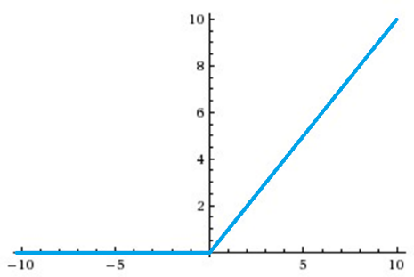
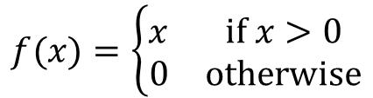
Activation Function
Using another functions instead of sigmoid
Rectified Linear Unit (ReLU)
$$f(x)=\left\{\begin{matrix}x & if x>0 \\ 0 & otherwise\end{matrix}\right.$$

Slide 9
Activation Function
Advantage
No vanishing gradient problems.
Deep networks can be trained without pre-training
Sparse activation
In a randomly initialized network, only about 50% of hidden units are activated
Fast computation:
6 times faster than sigmoid function
Disadvantage
Knockout Problem

Slide 10
Activation Function
ReLU units can be fragile
What if a node is never fired for all the data points (always negative) -> Never trained!!
For example,
If a large gradient flowing through a ReLU, it makes big updates of weights
Weights can locate at very bad points where the neuron will never activate on any data point again.
You may find that as much as 40% of your network can be "dead" (i.e. neurons that never activate across the entire training dataset) if the learning rate is set too high.
With a proper setting of the learning rate this is less frequently an issue.

Slide 11
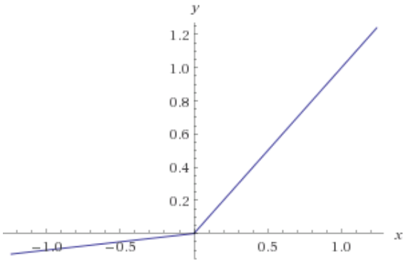
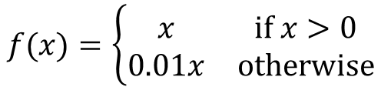
Activation Function
You may use another
Leaky ReLU
$$f(x)=\left\{\begin{matrix}x & if x>0 \\ 0.01x & otherwise\end{matrix}\right.$$

Slide 12
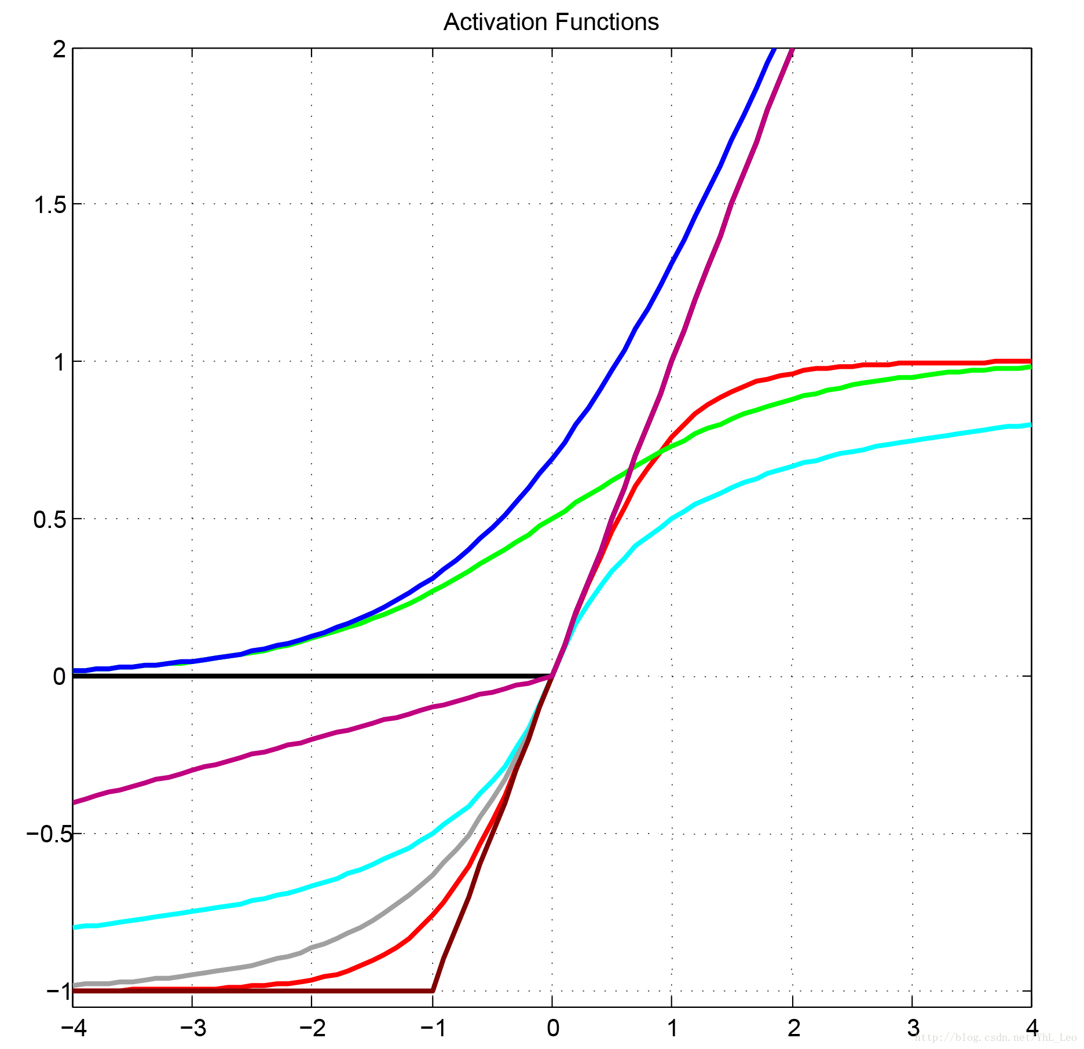
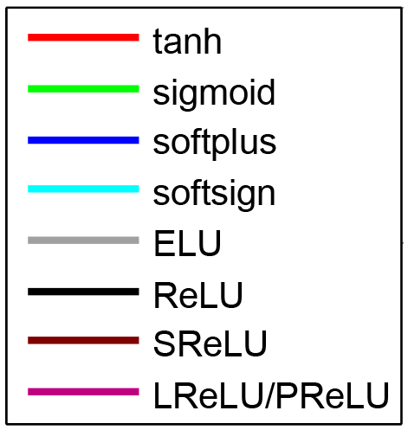
Other Activation Functions

Slide 13
Activation Function
Summary
Sigmoid functions and their combinations generally work better but are sometimes avoided due to the vanishing gradient problem
ReLU function is a general activation function and is used in most cases these days
If we encounter a case of dead neurons in our networks the leaky ReLU function is the best choice
ReLU function is usually used in the hidden layers
As a rule of thumb, you can begin with using ReLU function and then move over to other activation functions in case ReLU doesn’t provide with optimum results

Slide 14
Good Initialization

Slide 15
Greedy Layer-wise Training
Fully-Connected Network
Unsupervised pre-training
Greedy layer-wise training
Dimension reduction
Feature extraction
Providing Good Initial Weights to the next supervised learning step
Supervised fine tuning
Same as usually supervised learning
Whole weights are modified by gradient descent methods

Slide 16

Greedy Layer-wise Training
Curse of Dimensionality Facial Expression Recognition
256x256 image, 65,536 dimension vector
Is to good for facial recognition?
Maybe, a lower dimension vector is ENOUGH!!

Slide 17
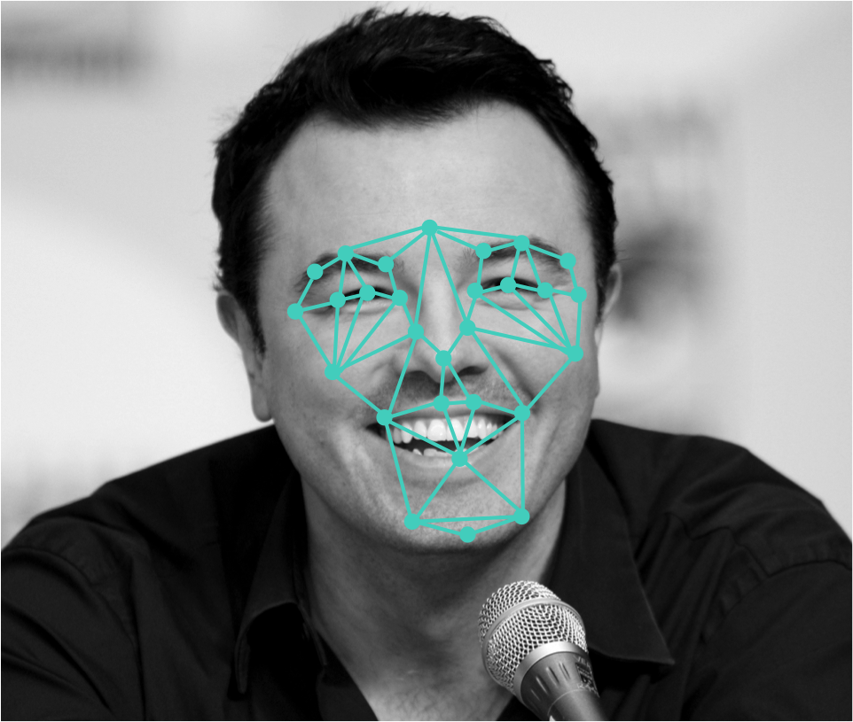
Greedy Layer-wise Training
Curse of Dimensionality Facial Expression Recognition
Define some facial keypoints
Use the distances between them as features
60 dimension vector is enough

Slide 18
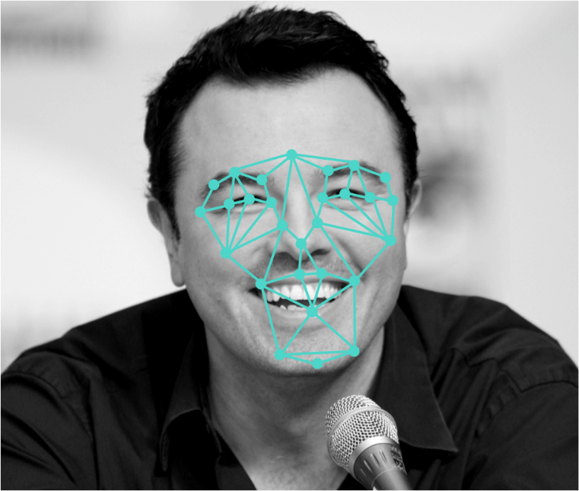
Greedy Layer-wise Training
Dimension Reduction
Or, Feature Extraction
65,536 dimension
60 dimension

Slide 19

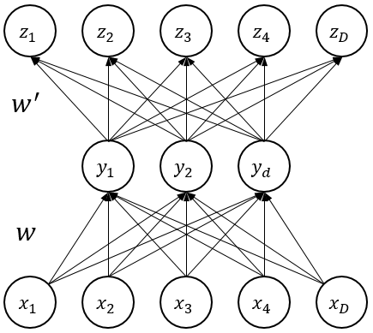
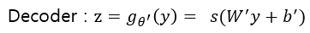
Greedy Layer-wise Training
Autoencoder
A way of dimension reduction
Values of hidden nodes can be interpreted as a low dimensional representation of the input

Slide 20
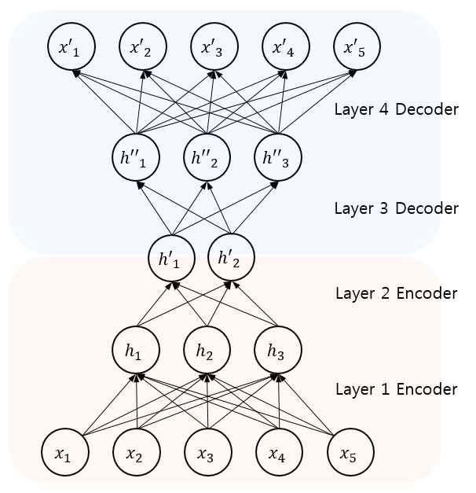
Greedy Layer-wise Training
Stacked Autoencoder (Deep Network)
A very low dimensional representation of the input
How to train the network coping with VANISHING GRADIENTS?

Slide 21
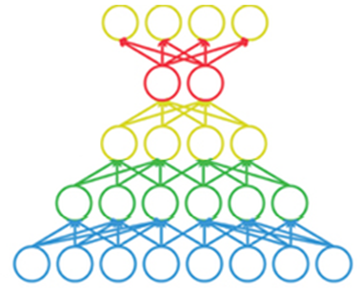
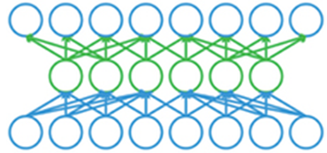
Greedy Layer-wise Training
Greedy Layer-Wise Training
1. Training an autoencoder
2. Copy connection weights

Slide 22
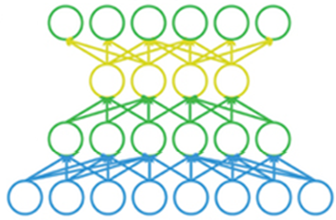
Greedy Layer-wise Training
Greedy Layer-Wise Training
1. Training an autoencoder
2. Copy connection weights

Slide 23
Greedy Layer-wise Training
Greedy Layer-Wise Training
1. Training an autoencoder
2. Copy connection weights

Slide 24
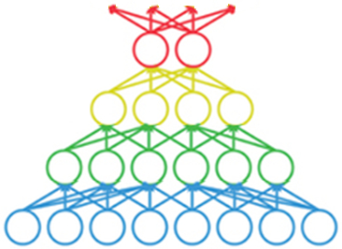
Greedy Layer-wise Training
Unsupervised Pre-training
Feature extractor
A low dimensional representation
= good features
Feature
extractor

Slide 25
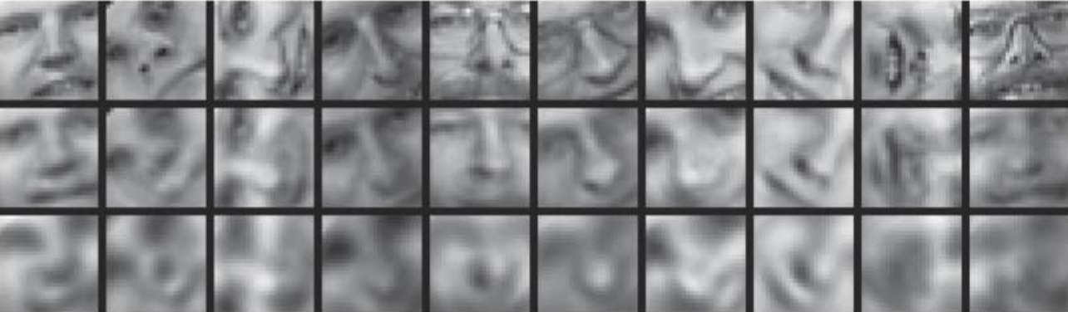
Greedy Layer-wise Training
Unsupervised Pre-training
Feature extractor
Original image
Recovered image using features by SA
Recovered image using features by PCA

Slide 26
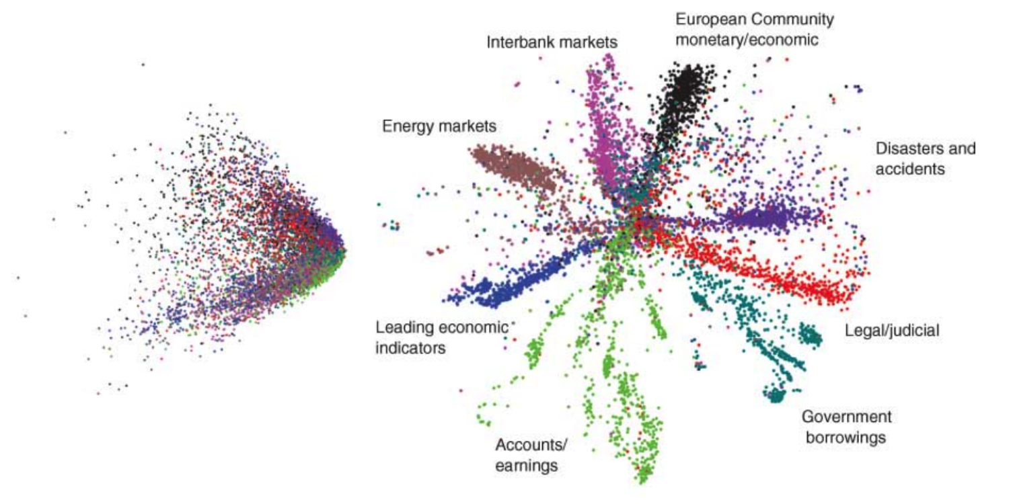
Greedy Layer-wise Training
Unsupervised Pre-training
Documents

Slide 27
Greedy Layer-wise Training
Supervised Fine Tuning
Stacking another fully connected layers
Training all the weights
Fully connected layer
Classifier
Feature
extractor

Slide 28
Greedy Layer-wise Training
Types
Deep Belief Networks (DBN)
Stacked Autoencoder (SA)
Stacked Denoising Autoencoder (SdA)
Sparse Autoencoder

Slide 29
Dropout

Slide 30
Regularization
What is Regularization
Introducing additional information to prevent over-fitting
Approaches
Early stopping, Max norm constraints, Weight decay Dropout, DropConnect, Stochastic pooling

Slide 31
Regularization
Early Stopping
Stop learning before converging to much
Hard to determine the time to stop
Usually determined by validation dataset
Max norm constraints
Enforcing weight vectors not to grow over given constant c
If it grows over c, cut its length to c.

Slide 32
Regularization
Weight Decay
L1 Regularization
Leading most weights very close to zero
Choosing a small subset of most important inputs
Resistant to noise in the inputs.
L2 Regularization
Penalizing peaky weights
Encouraging to use all of its inputs a little rather than using only some of its inputs a lot.

Slide 33
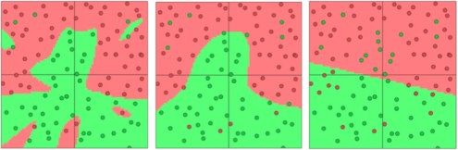
Regularization
Weight Decay
Example: Separating green and red
L2 regularization strengths of 0.01, 0.1, and 1

Slide 34
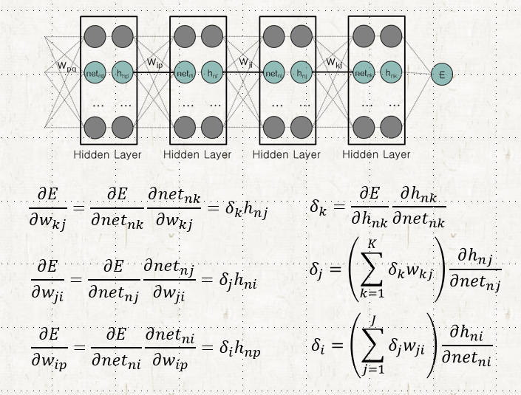
Dropout
In a complex Neural Network
All nodes do not take the same amount of responsibility
While training, some nodes are correlated
All nodes are not equally trained
Some nodes are trained much, but some are not
If the output of the node is bad, the connection weight will decrease.
If connection weight is close to 0, precedent connection weights are hardly trained.

Slide 35
Dropout
How can we reduce the structural complexity?
Let’s simply remove some nodes, and
Train the simplified neural network
Hmm??
X
X
X
X
X
X
X

Slide 36
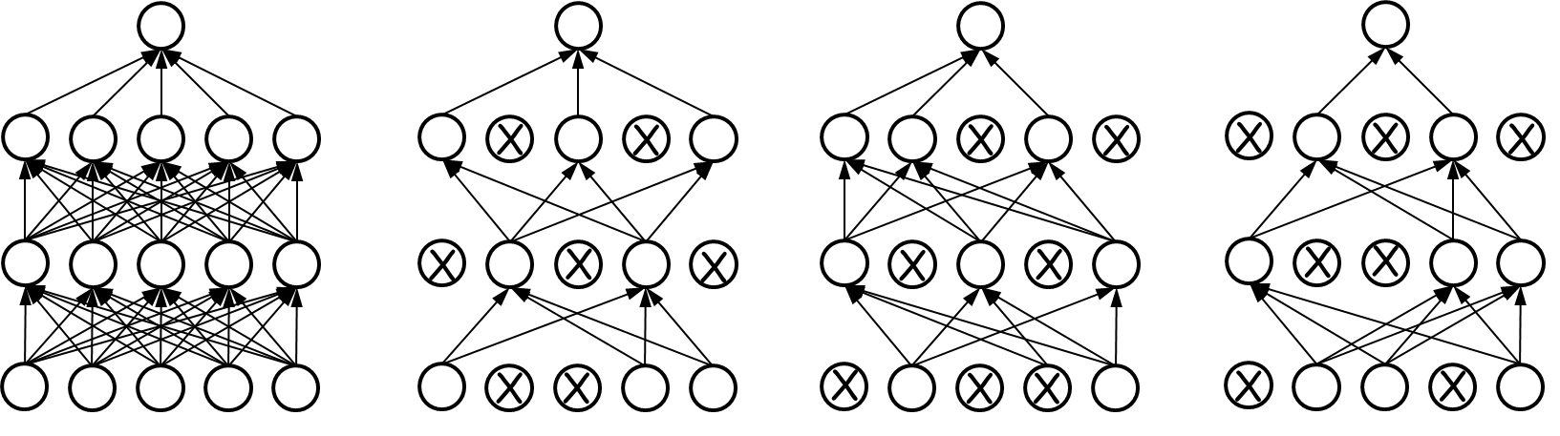
Dropout
Do this at every epoch
Randomly choose nodes with a probability of p
Usually p = 0.5
Train the simplified neural network
At every epoch, we train different neural network which share connection weight each other
…
Original network
Epoch 1
Epoch 2
Epoch 3

Slide 37
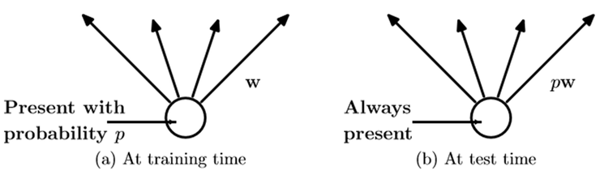
Regularization
Testing
Use all the nodes without dropout
Instead, the connection weight is scaled by p
Why?

Slide 38
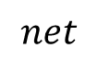
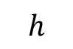
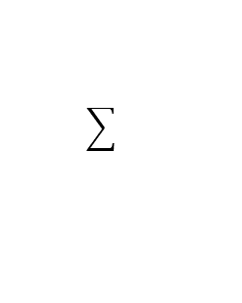
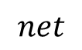
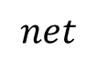
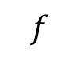
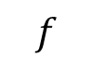
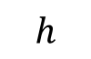
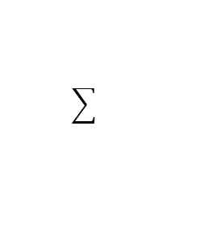
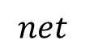
Dropout
Testing
Use all the nodes without dropout
Instead, the connection weight is scaled by p
Outgoing weigh에 dropout_rate를 곱한다
Why?
=> Some kind of averaging all the different neural networks
$$h$$
$$f$$
$$h$$
Average of net’s
$$f$$
$$net$$
$$net$$
$$net$$
$$net$$
…
NN 1
NN 2
NN 3

Slide 39
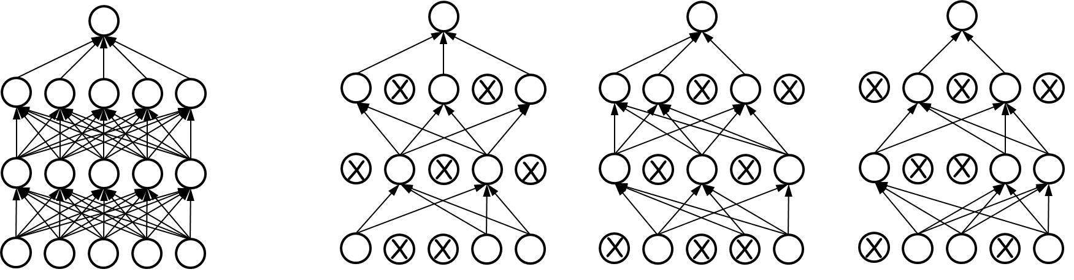
Dropout
Testing
Use all the nodes without dropout
Instead, the connection weight is scaled by p
Why?
=> Some kind of averaging all the different neural networks
…
…
Original network
NN 1
NN 2
NN 3

Slide 40
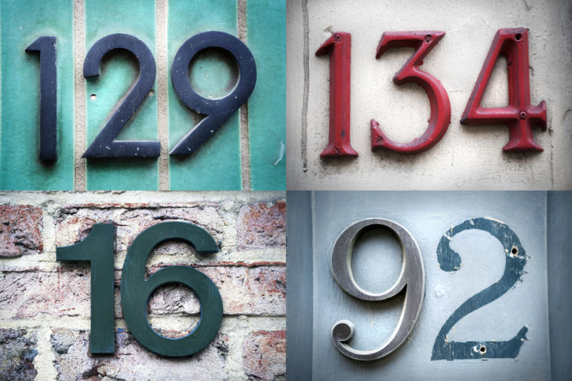
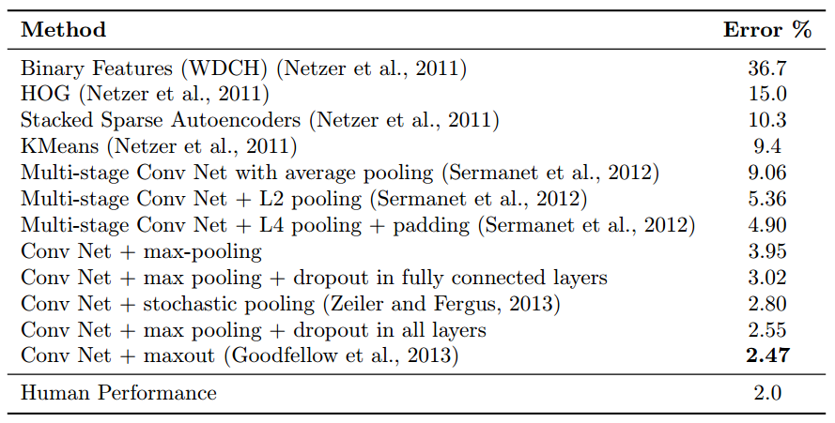
Dropout
Experimental Results
SVHN – Street View House Numbers
Dropout is applied also to convolutional layers.
All hidden units are ReLUs.

Slide 41

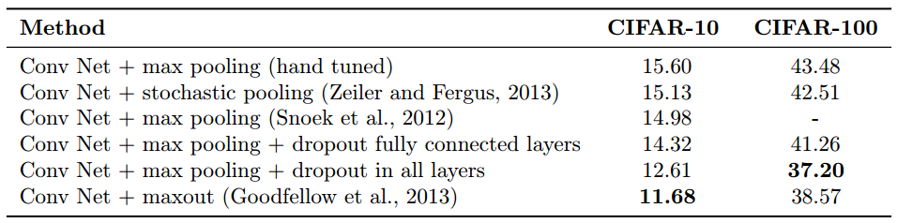
Dropout
Experimental Results
CIFAR-10 and CIFAR-100:
Images drawn from 10 and 100 categories respectively.

Slide 42
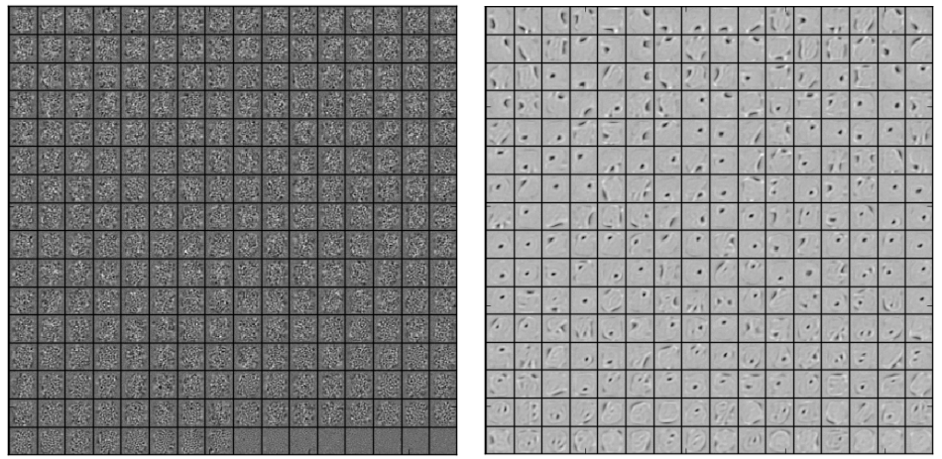
Dropout
The effect of dropout on learned features:
Without dropout, units tend to compensate for mistakes of other units.
This leads to overfitting, since these co-adaptations do not generalize to unseen data.
Dropout prevents co-adaptations by making the presence of other hidden units unreliable.
MNIST, one hidden layer, 256 ReLUs
No Dropout
Dropout p=0.5

Slide 43
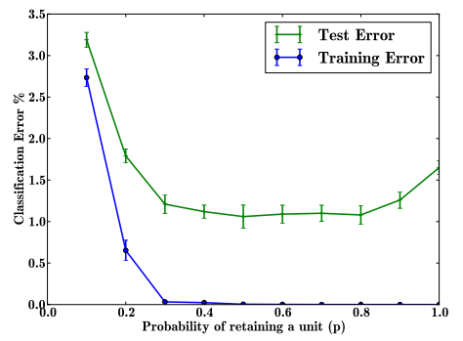
Dropout
The effect of the dropout rate 𝑝:
An architecture of 784-2048-2048-2048-10 is used on the MNIST dataset.
The dropout rate 𝑝 is changed from small numbers (most units are dropped out) to 1.0 (no dropout).
Dropout with high probability
No Dropout
->Overfitting

Slide 44
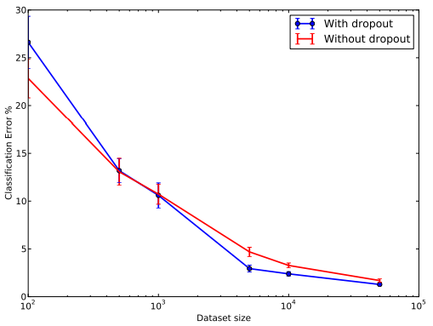
Dropout
The effect of data set size:
An architecture of 784-1024-1024-2048-10 is used on the MNIST dataset.
Extremely small data set
- Dropout does not improve error rate, and even makes it worse.
Huge data set
- Dropout barely improves the error rate. The data set is big enough, so that overfitting is not an issue.
Average to large data set
- Dropout improves error rate.

Slide 45
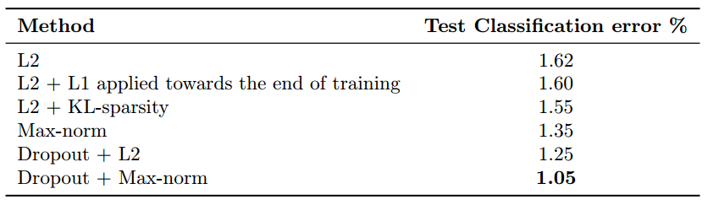
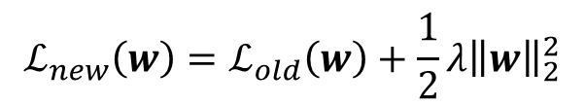
Dropout
Limiting the growth of the weights in the network.
A term is added to the original loss function, penalizing large weights:
A network architecture of 784-1024-1024-2048-10 is used on the MNIST data set, with different regularizations.
$$ℒ_{new}\left(w\right)=ℒ_{old}\left(w\right)+\frac{1}{2}λ{\left\|w\right\|}_{2}^{2}$$

Slide 46
Dropout
Dropout has more advantages over weight decay (Helmblod et al., 2016):
Dropout is scale-free: dropout does not penalize the use of large weights when needed.
Dropout is invariant to parameter scaling: dropout is unaffected if weights in a certain layer are scaled up by a constant 𝑐, and the weights in another layer are scaled down by a constant 𝑐. This implies that dropout does not have an isolated local minima.

Slide 47
Dropout
Summary
Dropout is a very good and fast regularization method.
Dropout is a bit slow to train (2-3 times slower than without dropout).
If the amount of data is average-large – dropout excels. When data is big enough, dropout does not help much.
Dropout achieves better results than former used regularization methods (Weight Decay).

Slide 48
Batch Normalization

Slide 49
Batch Normalization
Covariate Shift
A change in the distribution of a function’s domain.
Can your model work properly?
y
You see these data when training a model
But, you have these data when testing the model
x

Slide 50
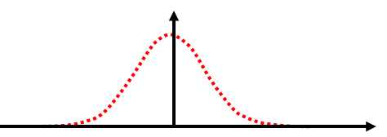
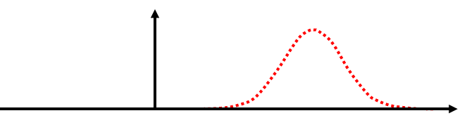
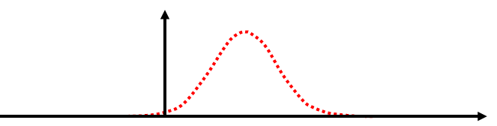
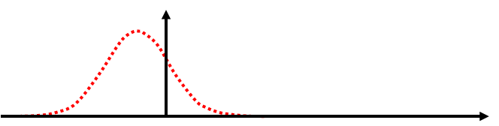

Batch Normalization
Internal Covariate Shift
The distribution of the input to a layer changes if you change the connection weights
This change propagates to the upper layers
After weights change
Distribution of inputs to a node
Distribution may change!!

Slide 51


Batch Normalization
Internal Covariate Shift
Input distribution of the red node
While learning, red connection weights will change based on the input distribution
After learning, the whole connection weights changes, which cause the change of the input distribution
The assumption of the learning is broken

Slide 52
Batch Normalization
Internal Covariate Shift
It disturbs the learning process,
Learning is getting slow down
What shall we do?
Why don’t we normalize the distribution of inputs
Distorted distribution
Normalized distribution

Slide 53







Batch Normalization
Input Normalization
Let’s assume that the input distribution of any nodes is Gaussian
Training Data
(d=1,2,…,D)
Distribution of net_{i}
Transform
$${\hat{net}}_{di}=\frac{{net}_{di}−μ}{\sqrt{σ^{2}}}$$
$${net}_{di}=\sum_{j=1}^{J}{w_{j}x_{dj}}+b$$
$$μ=\frac{1}{D}\sum_{d=1}^{D}{{net}_{di}}$$
$$σ^{2}=\frac{1}{D}\sum_{d=1}^{D}{{\left({net}_{di}−μ\right)}^{2}}$$
$$h_{di}=Activation\left({\hat{net}}_{di}\right)$$
$$h_{di}=Activation\left({net}_{di}\right)$$

Slide 54
Batch Normalization
Input Normalization
Calculating the average and the variance of the whole training data is inefficient
Let’s normalize inputs with respect to each batch
If we use Sigmoid or Tanh as the activation function, non-linearity disappear
Let’s add linear transform after normalization
Behavior of Sigmoid around 0 is almost linear!!

Slide 55






Batch Normalization
Input Normalization
Let’s assume that the input distribution of any nodes is Gaussian
Batch
…
Batch
Batch
Distribution of net_{i} in B
Training data
$${\hat{net}}_{di}=\frac{{net}_{di}−μ_{B}}{\sqrt{σ_{B}^{2}+ε}}$$
Transform
$${net}_{di}=\sum_{j=1}^{J}{w_{j}x_{dj}}+b$$
$$μ_{B}=\frac{1}{D_{B}}\sum_{d=1}^{D_{B}}{{net}_{di}}$$
$$σ_{B}^{2}=\frac{1}{D_{B}}\sum_{d=1}^{D_{B}}{{\left({net}_{di}−μ\right)}^{2}}$$
$$y_{di}=γ{\hat{net}}_{di}+β$$
$$h_{di}=Activation\left(y_{di}\right)$$
$$h_{di}=Activation\left({net}_{di}\right)$$

Slide 56

Batch Normalization
Structure of Networks

Slide 57















Batch Normalization
For a Single Node
$$h_{di}$$
$$h_{di}$$
i
$$h_{di}=Activation\left(y_{di}\right)$$
$$y_{di}=γ{\hat{net}}_{di}+β$$
$$γ,β$$
i
$$h_{di}=Activation\left({net}_{di}\right)$$
$${\hat{net}}_{di}$$
$${net}_{di}=\sum_{j=1}^{J}{w_{j}x_{dj}}+b$$
$${\hat{net}}_{di}=\frac{{net}_{di}−μ_{B}}{\sqrt{σ_{B}^{2}+ε}}$$
$$w_{j}$$
$$w_{j}$$
$$x_{dj}$$
$${net}_{di}=\sum_{j=1}^{J}{w_{j}x_{dj}}+b$$
$$x_{dj}$$
$$μ_{B}=\frac{1}{D_{B}}\sum_{d=1}^{D_{B}}{{net}_{di}}$$
$$σ_{B}^{2}=\frac{1}{D_{B}}\sum_{d=1}^{D_{B}}{{\left({net}_{di}−μ\right)}^{2}}$$

Slide 58















Batch Normalization
How to Work
$$E$$
$$h_{1i}$$
$$h_{2i}$$
…
$$h_{Bi}$$
$$h_{di}$$
i
$$h_{di}=Activation\left({net}_{di}\right)$$
$${net}_{di}=\sum_{j=1}^{J}{w_{j}x_{dj}}+b$$
$${net}_{1i}$$
$${net}_{2i}$$
…
$${net}_{Bi}$$
$$w_{j}$$
$$x_{dj}$$
$$w$$
$$x_{1}$$
$$x_{2}$$
…
$$x_{B}$$
update

Slide 59



















Batch Normalization
How to Work
$$E$$
$$h_{di}$$
$$h_{1i}$$
$$h_{2i}$$
…
$$h_{Bi}$$
$$h_{di}=Activation\left(y_{di}\right)$$
$$γ,β$$
i
$$y_{di}=γ{\hat{net}}_{di}+β$$
$${\hat{net}}_{1i}$$
$${\hat{net}}_{2i}$$
…
$${\hat{net}}_{Bi}$$
$$γ,β$$
$${\hat{net}}_{di}$$
$$μ_{B},σ_{B}^{2}$$
$${\hat{net}}_{di}=\frac{{net}_{di}−μ_{B}}{\sqrt{σ_{B}^{2}+ε}}$$
$${net}_{1i}$$
$${net}_{2i}$$
…
$${net}_{Bi}$$
$$w_{j}$$
$$w$$
$$x_{dj}$$
$$x_{1}$$
$$x_{2}$$
…
$$x_{B}$$
update

Slide 60

Batch Normalization
Input Transform
Normalize each batch by both mean and variance.
For each node, normalization performed independently

Slide 61






Batch Normalization
Testing
For Training, the mean and variance of each batch are used for normalization
For Testing, of which data the mean and variance will be used?
Estimated with those of batches in the training
Test sample
$${\hat{net}}_{ti}=\frac{{net}_{di}−μ}{\sqrt{σ^{2}+ε}}$$
Transform
$${net}_{ti}=\sum_{j=1}^{J}{w_{j}x_{tj}}+b$$
$$μ=\frac{1}{B}\sum_{b=1}^{B}{μ_{b}}$$
Unbiased estimator of mean of the population
$$y_{ti}=γ{\hat{net}}_{ti}+β$$
$$σ^{2}=\frac{1}{B}\sum_{b=1}^{B}{{\frac{m}{m−1}σ}_{b}^{2}}$$
Mean of unbiased estimator of variance of the population
B: # of batches
m: # of samples in each batch
$$h_{ti}=Activation\left(y_{ti}\right)$$

Slide 62
Batch Normalization
Advantage
Reduces internal covariant shift.
Reduces the dependence of gradients on the scale of the parameters or their initial values.
Regularizes the model and reduces the need for dropout, photometric distortions, local response normalization and other regularization techniques.

Slide 63

Batch Normalization
Performance with BN

Slide 64

Batch Normalization
Advantage
Learning faster: Learning rate can be increased compare to non-batch-normalized version.
Not-Stuck in the saturation mode: Even if ReLU is not used.
Higher accuracy: Flexible on data distribution in every hidden layer

Slide 65
Summary
Deep networks has strong power but cause many problems
Solutions for Training
High Model Complexity
Adopting deep but relatively simple structures
Hard to Optimize
Using another activation functions
Mini-batch gradient descent
Overfitting
(A huge amount of data)
Various Regularization Method (including Dropout)
Internal Covariate Shift
Batch normalization

